Slide 1
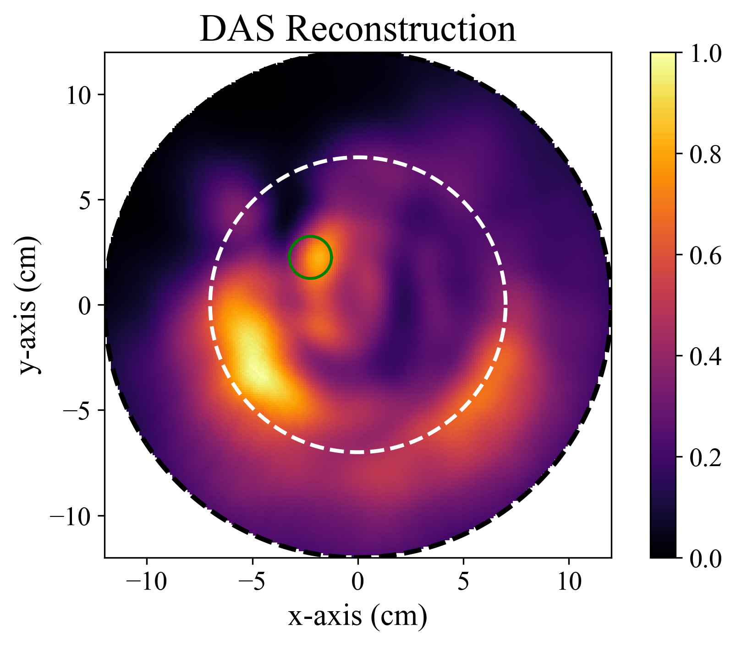
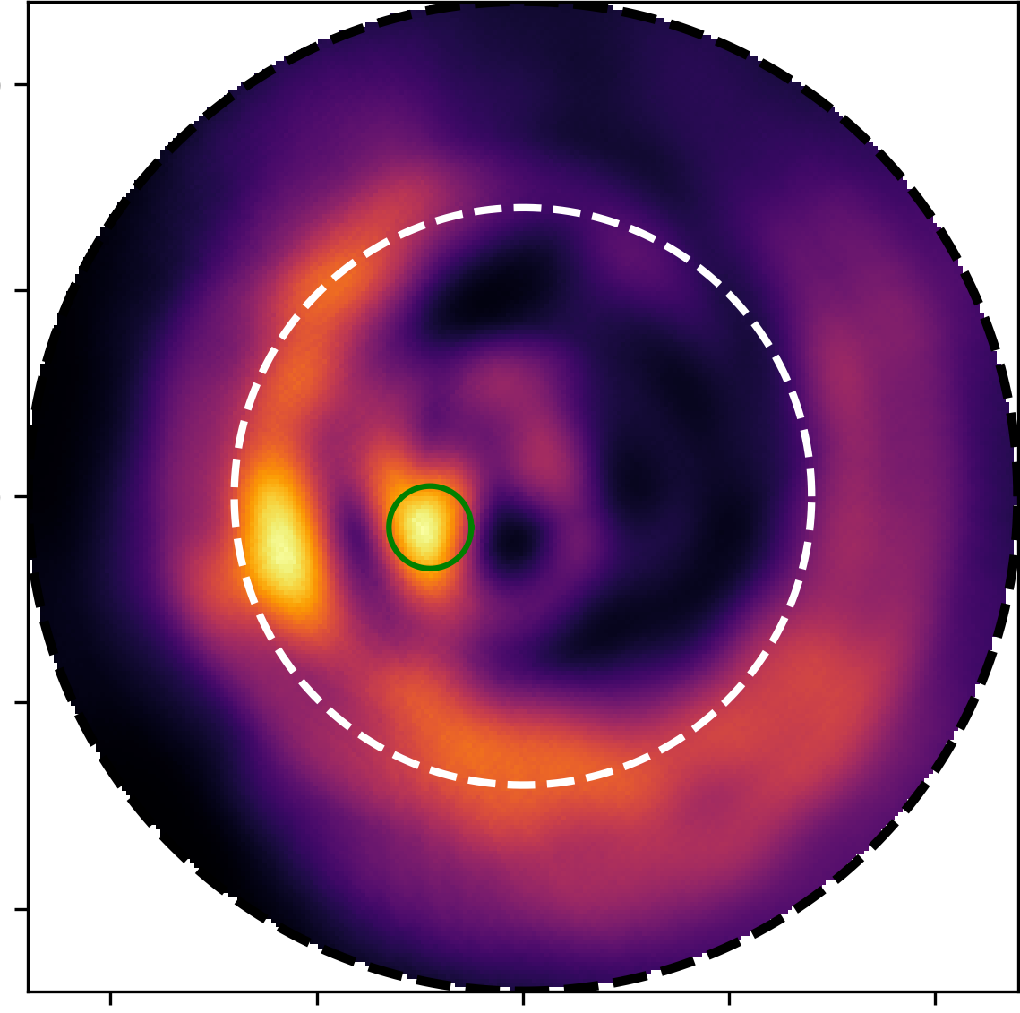
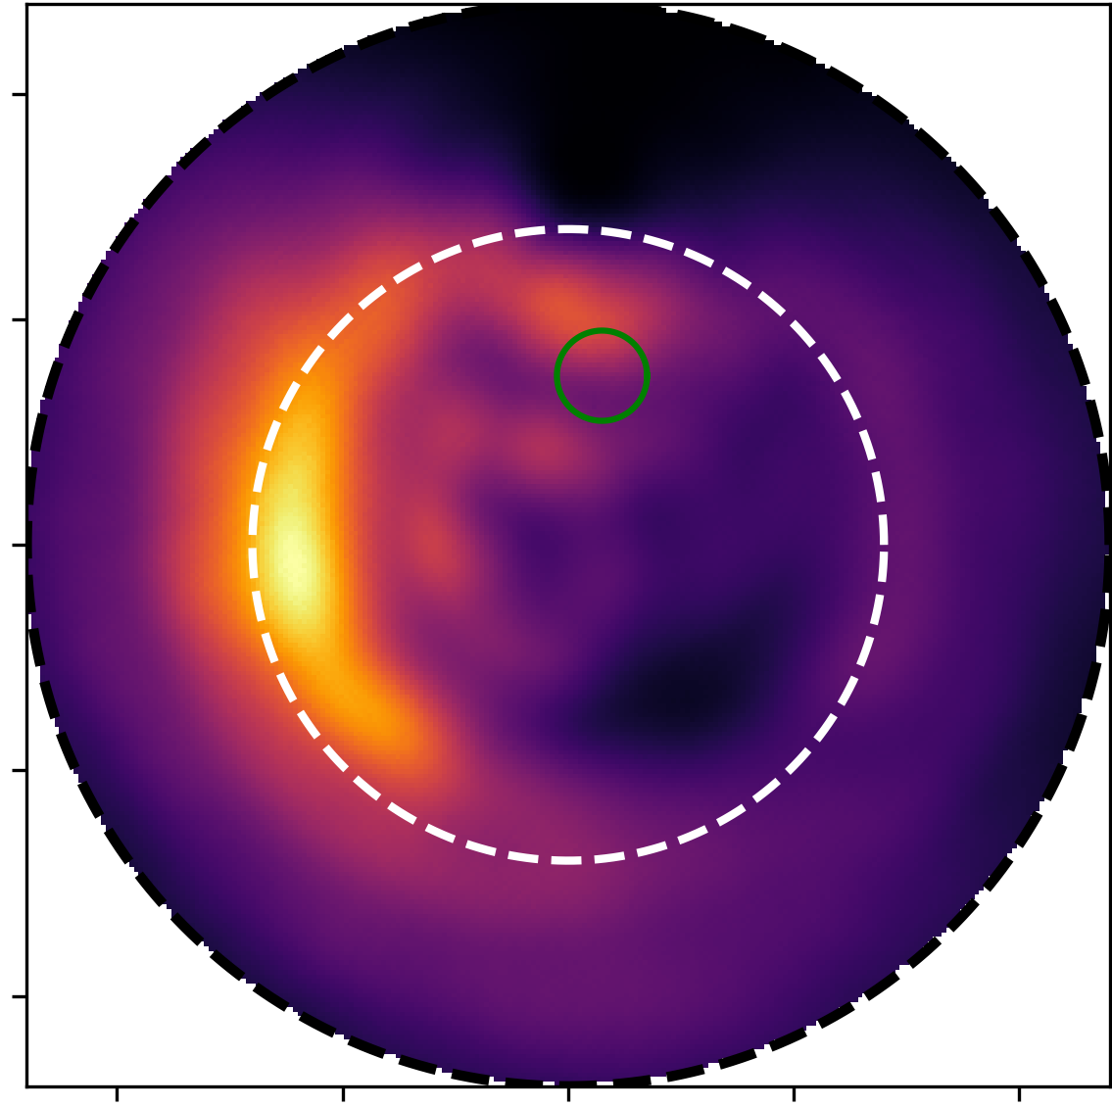
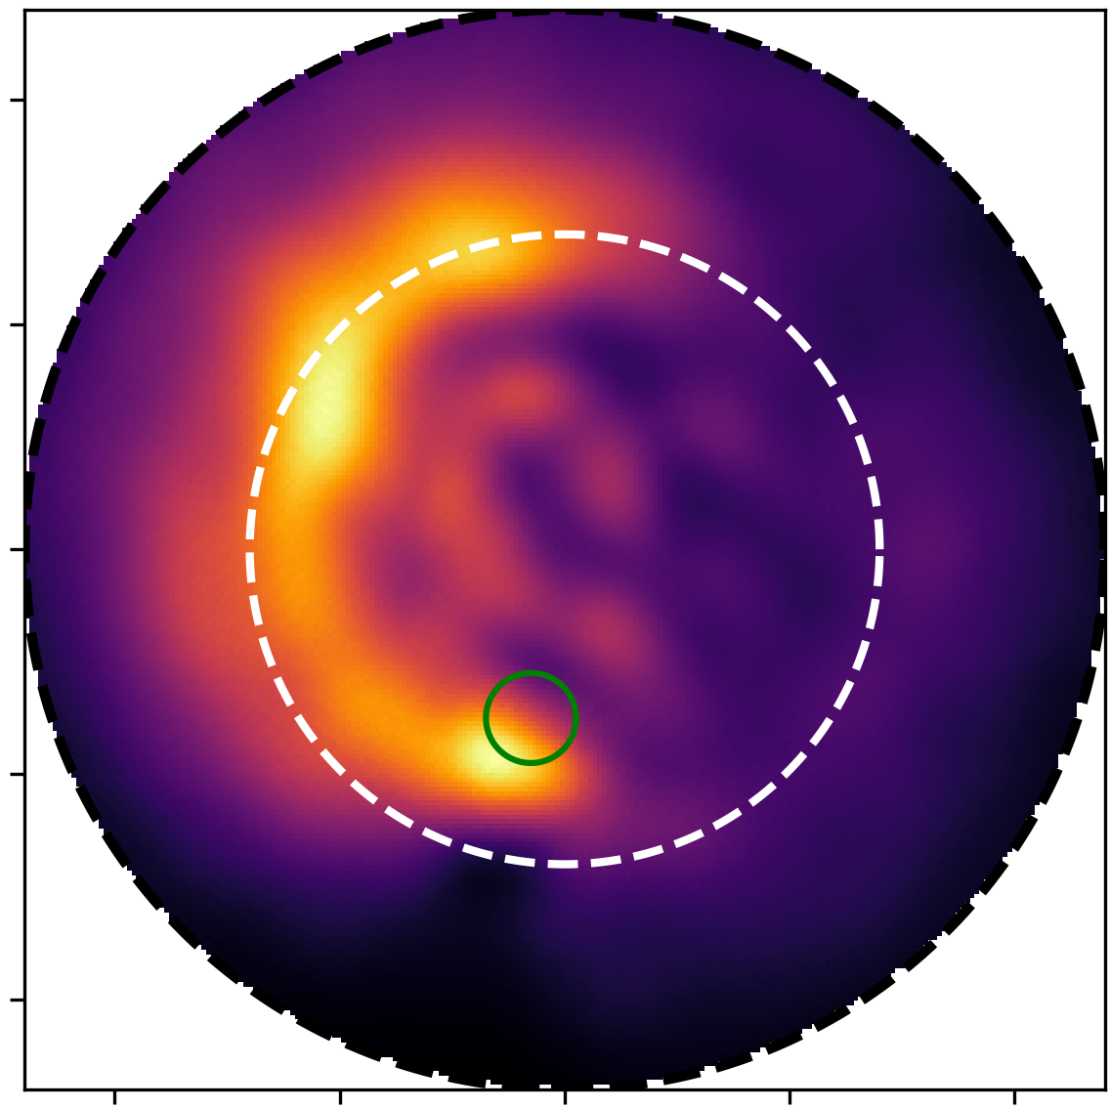
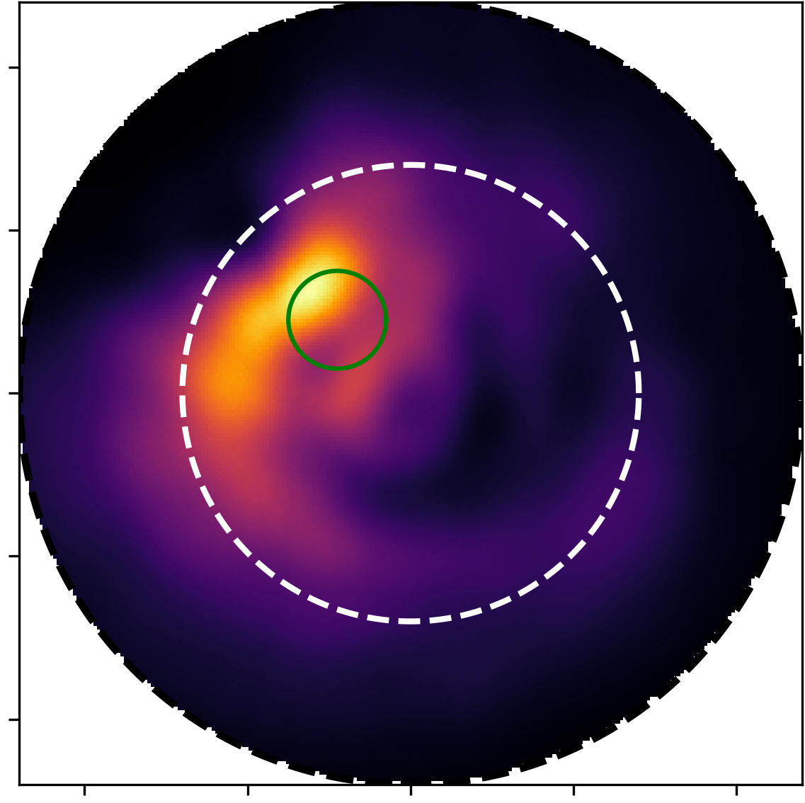
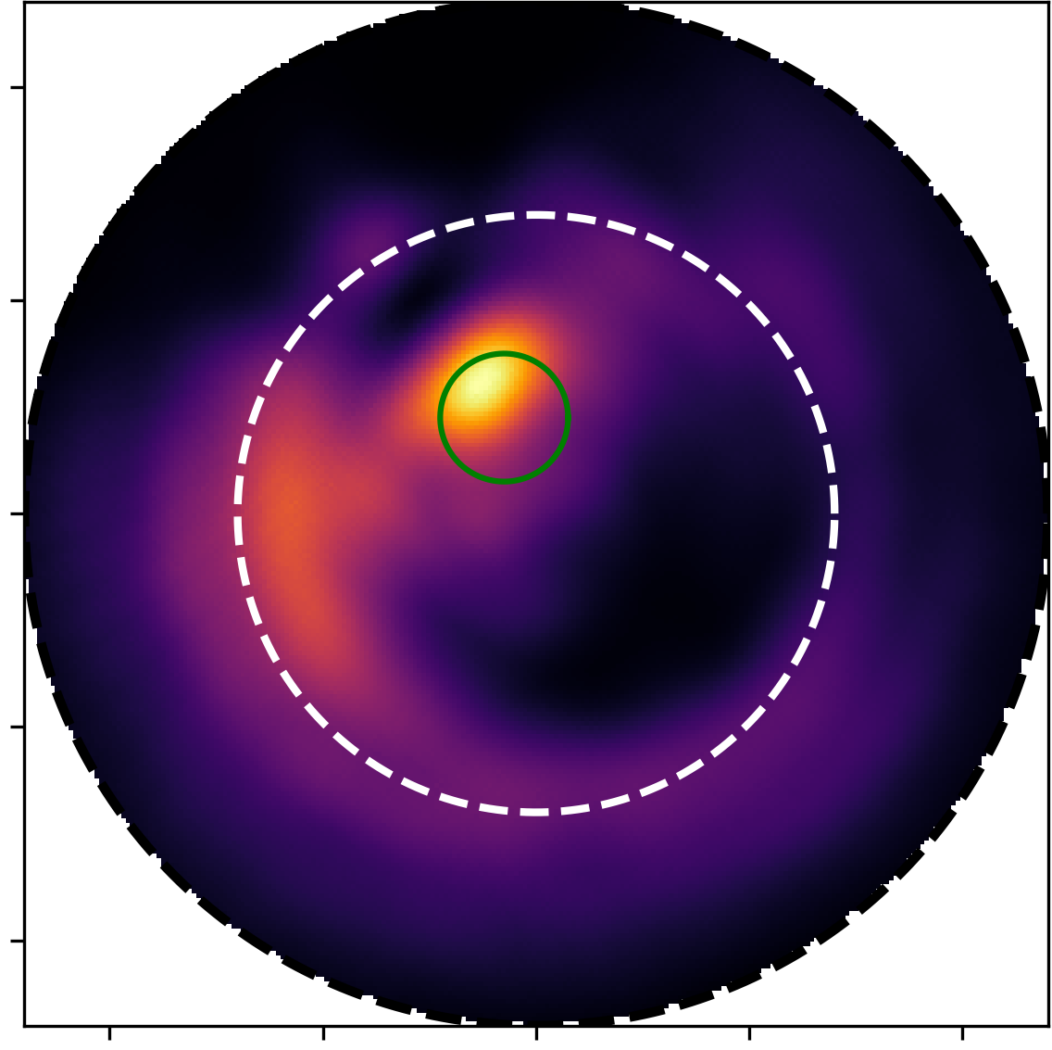
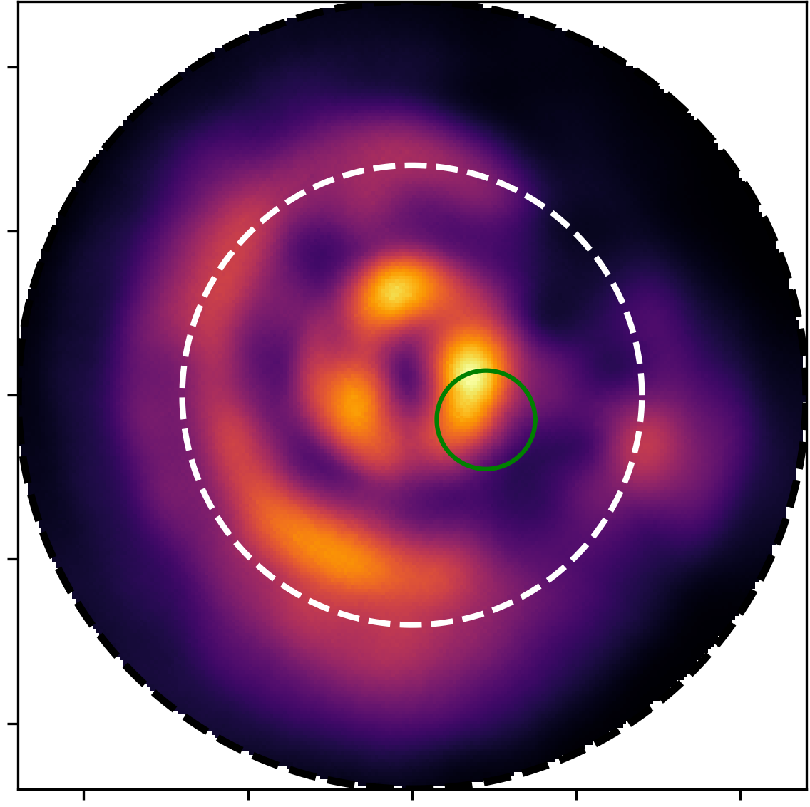
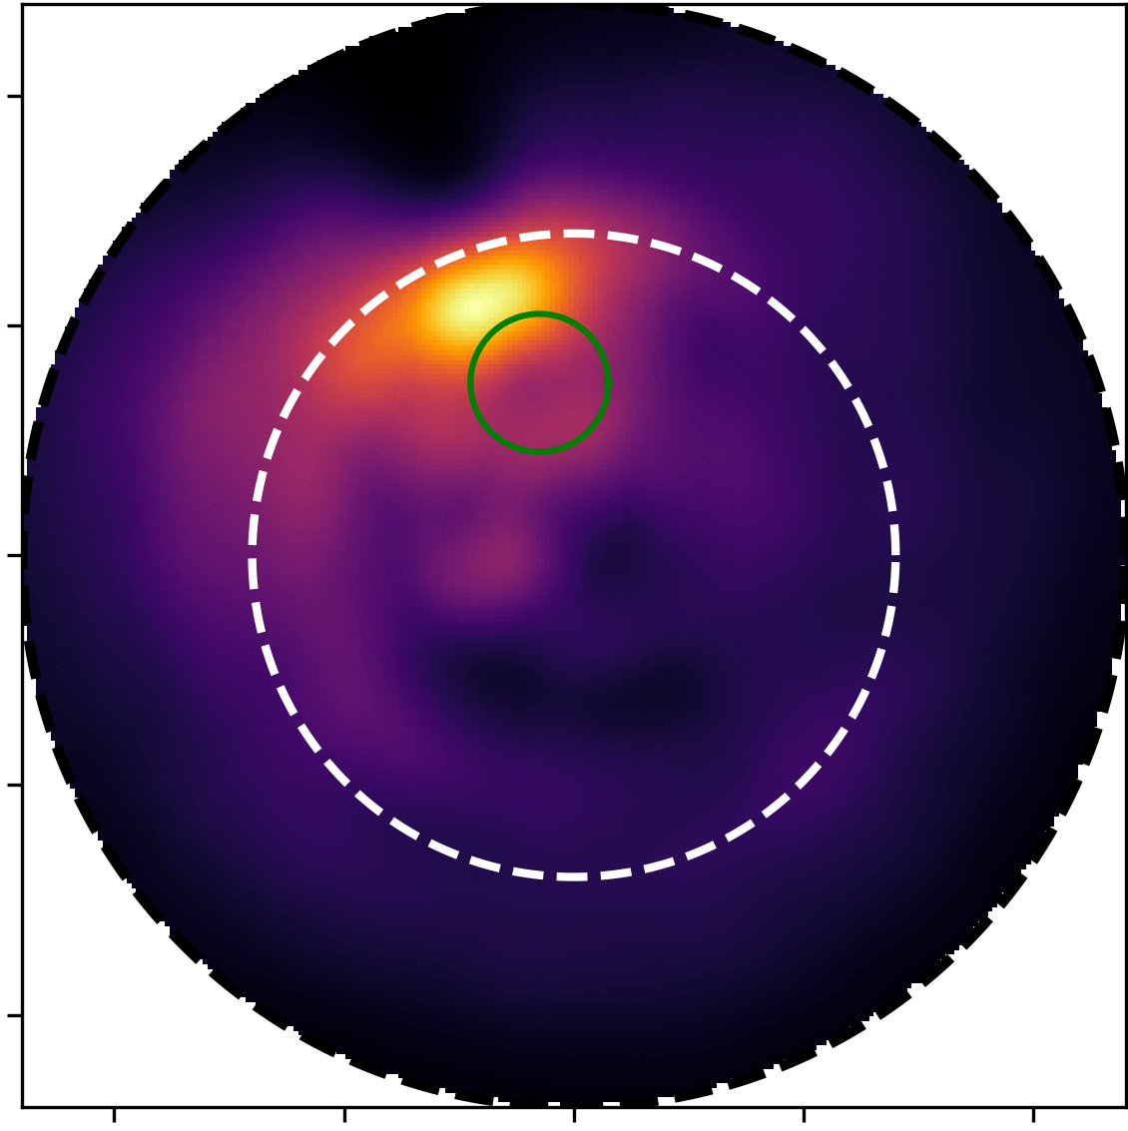
Average Propagation Speed
Scan 37
Scan 136
Scan 137
Scan 143
1.0 cm Tumour Radius
y-axis (cm)
-10 -5 0 5 10
-10 -5 0 5 10
x-axis (cm)
Scan 36
Scan 135
Scan 139
Scan 140
1.5 cm Tumour Radius

